Slide 1
Microsoft Excel 2
QCL Graduate Fellow

Slide 2
Before we start
Download Microsoft 360
https://www.microsoft.com/en-us/education/products/office
Survey sign-in
Github link

Slide 3
Agenda
Pivot Tables
Lookup functions
VLOOKUP (approximate match)
Index Match
Common functions
Count
Sum
Logical functions
IF
AND
OR
NOT
Set Up
Use

Slide 4
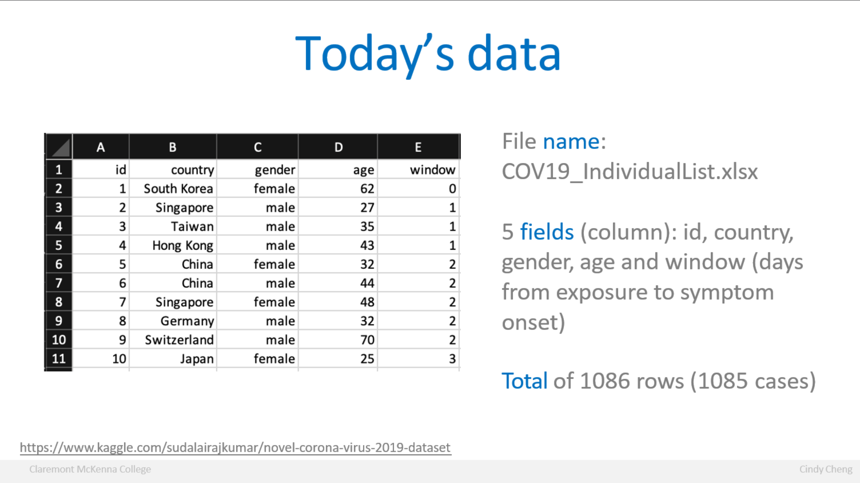

Slide 5
Excel 1 Content
Content
Sort, filter, conditional formatting
VLOOKUP (exact match)
Calculations (mean, min and max)
Frequency and histogram

Slide 6




Today’s Goals
A quicker way to look at data with Pivot Table and Pivot Chart
Make a simple search table with VLOOKUP (approximate match)
Use Common functions on your data
Use Logical functions on your data

Slide 7
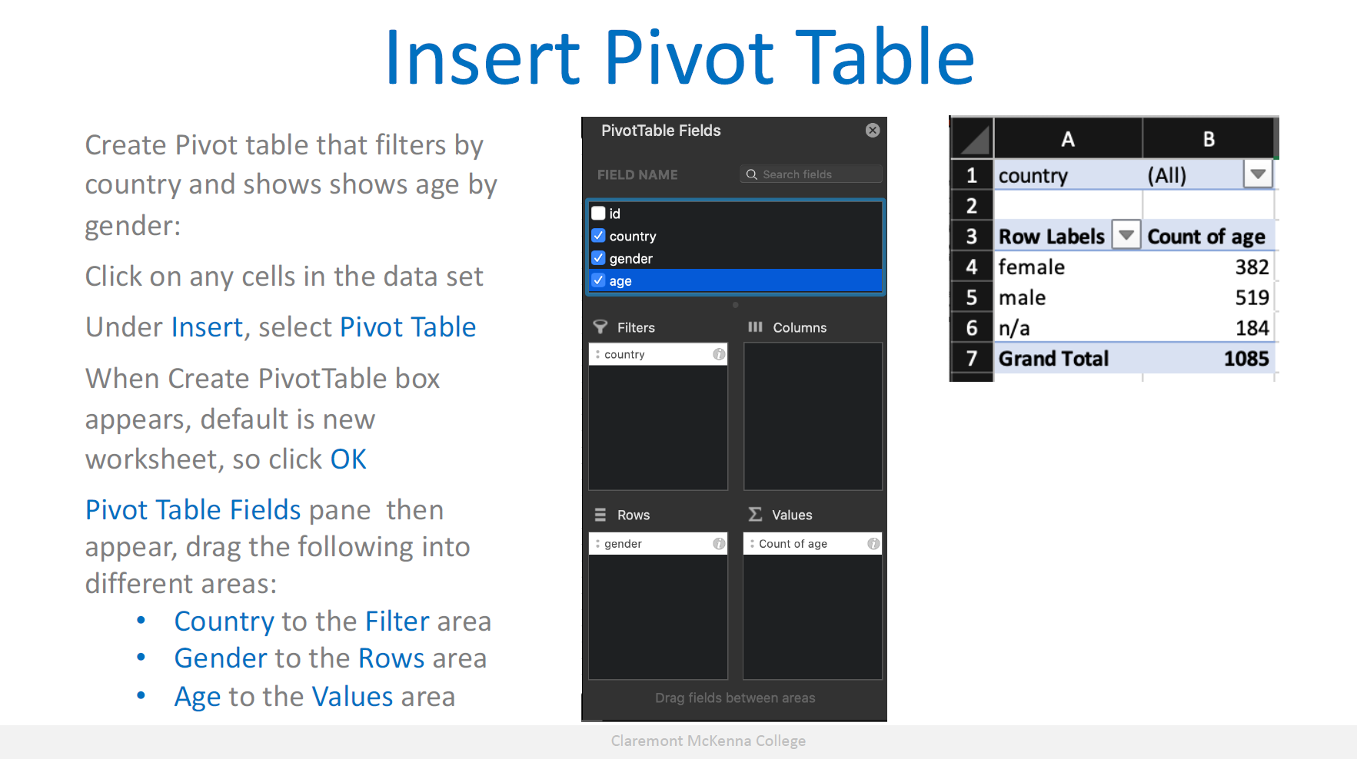

Slide 8
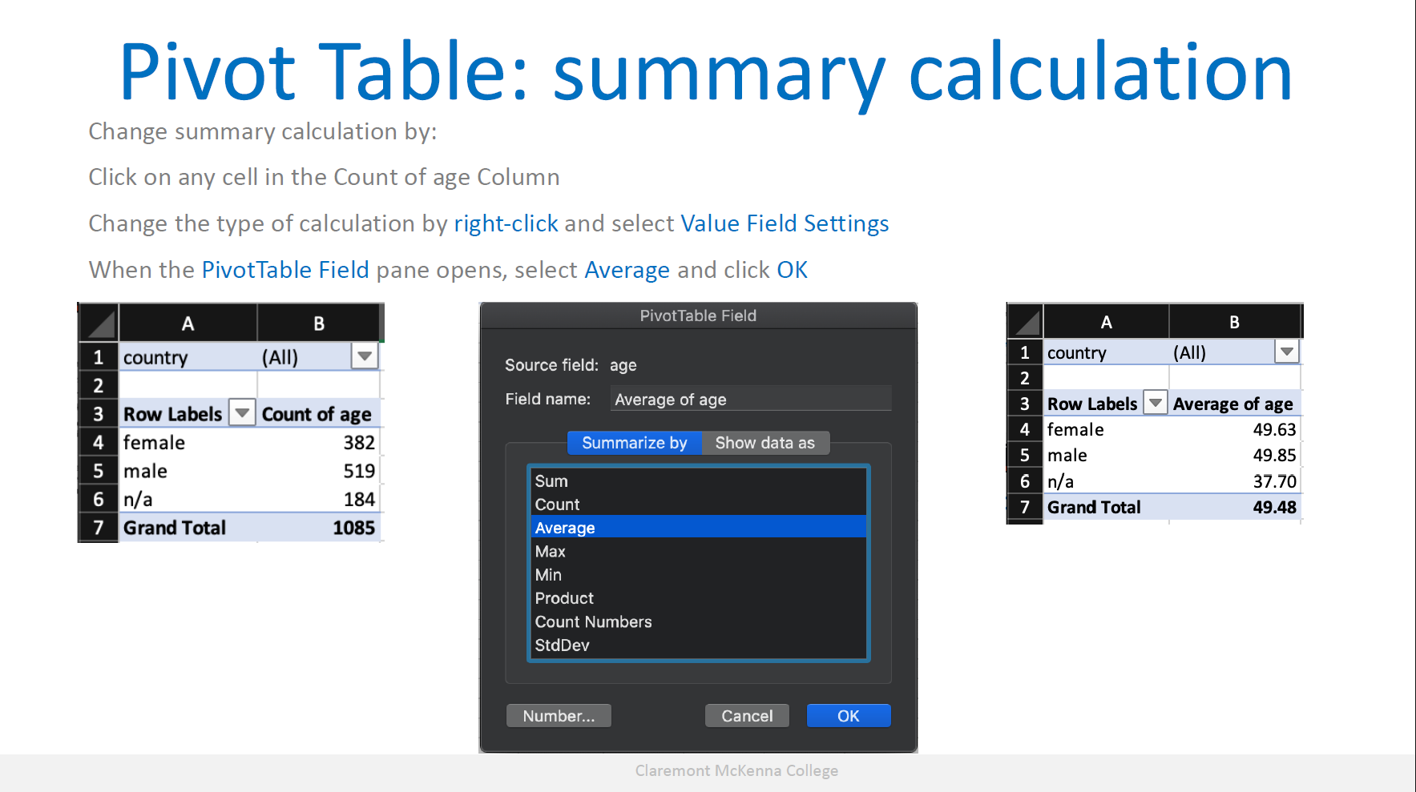

Slide 9
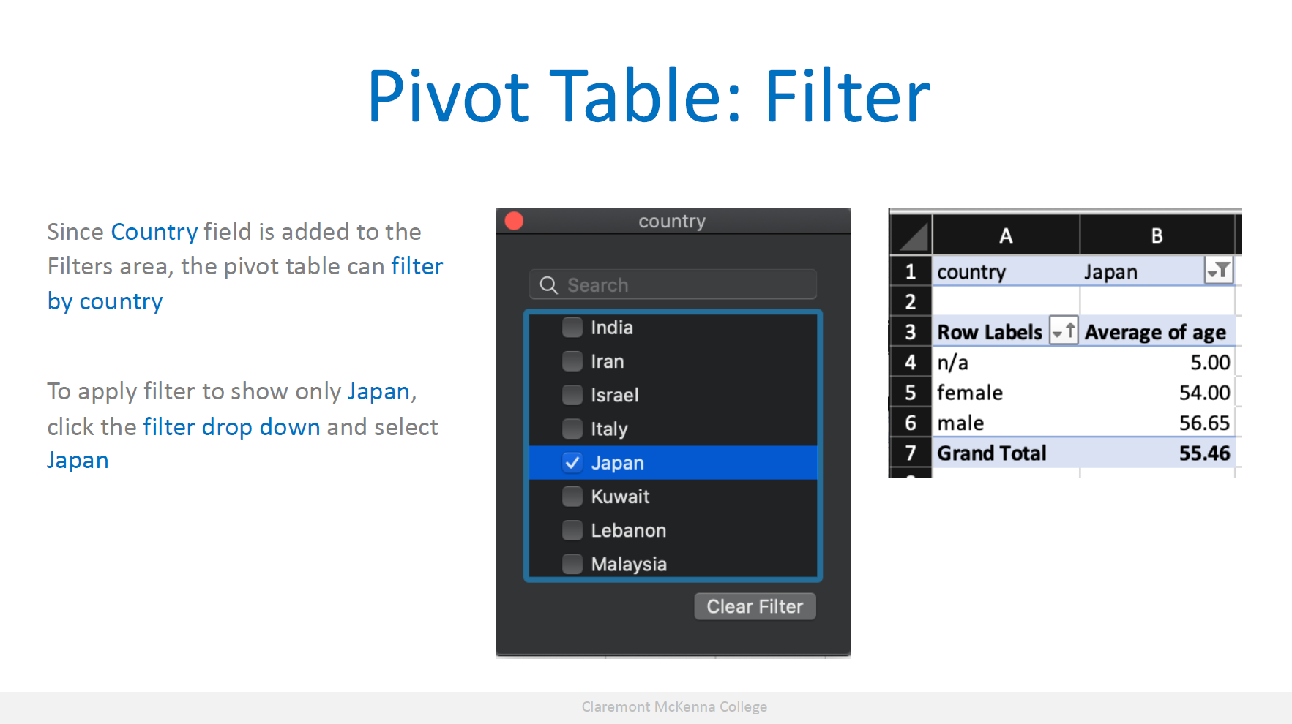

Slide 10
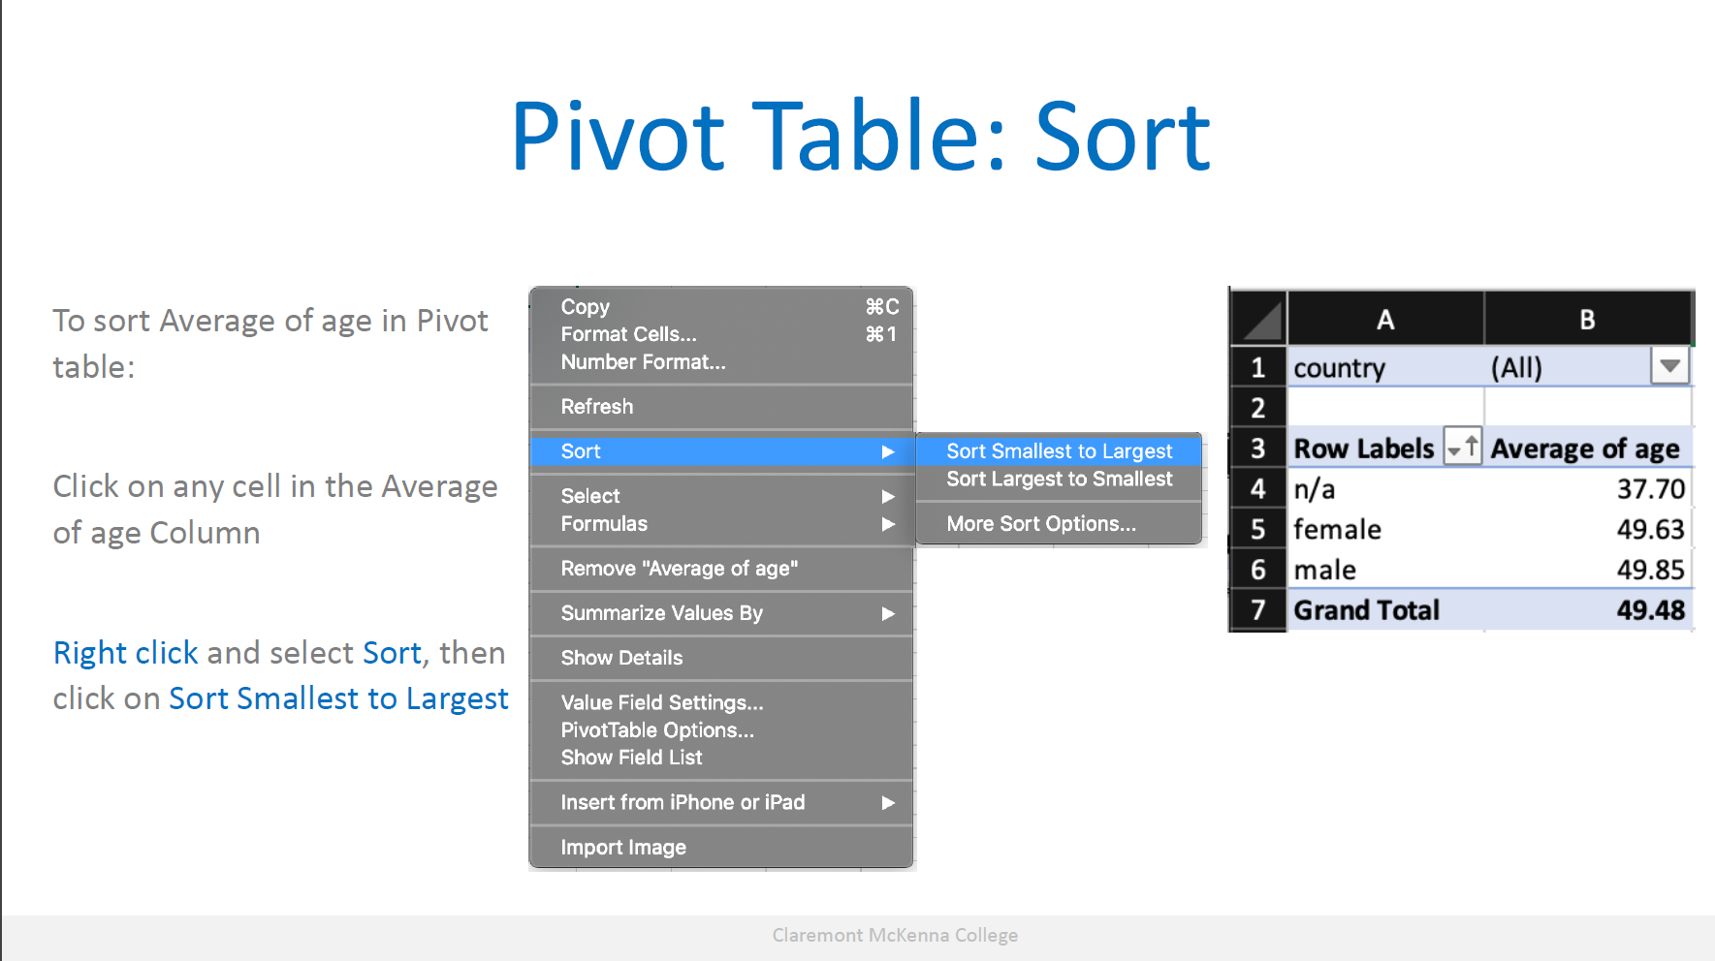

Slide 11
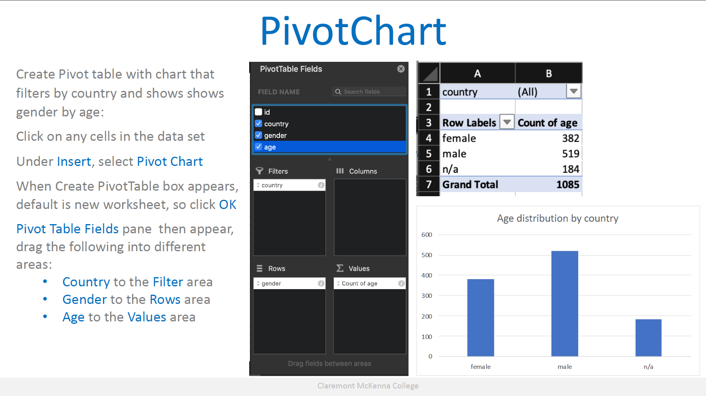

Slide 12
Hands-on exercise #1
Using the baltimore-city-employee-salaries-fy2019-1.xlsx file:
Build a pivot table that is filterable by department to show the name and ID of each employee. With the table, answer the following questions:
a. Dominic Bullock works in the City Council department, what is their ID?
b. How many employees work in the Election department?
https://data.world/baltimore/6xv6-e66h

Slide 13
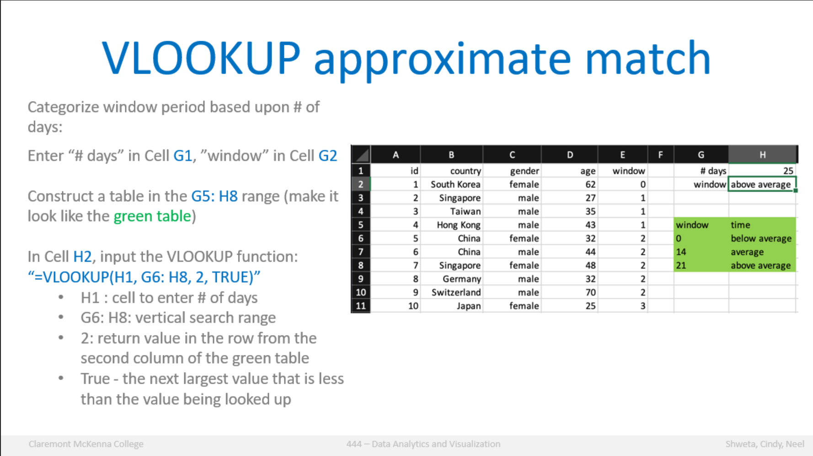

Slide 14
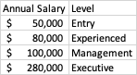
Hands-on exercise #2
Suppose you are a HR specialist and your supervisor, who is the HR director just gave you the baltimore-city-employee-salaries-fy2019-1.xlsx file:
Create a VLOOKUP approximate match function to categorize annual salary level based on the following table. What are the levels for annual salaries of $98765 and $51230
https://data.world/baltimore/6xv6-e66h

Slide 15
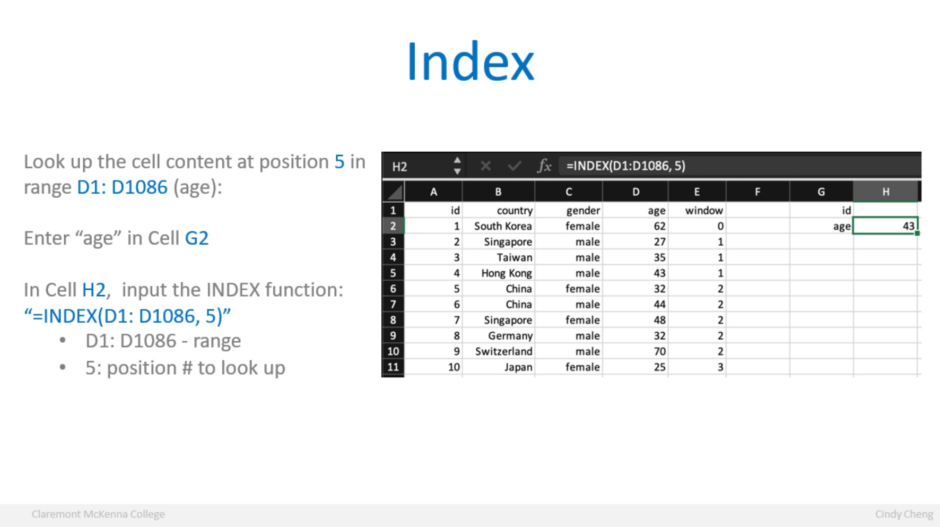

Slide 16
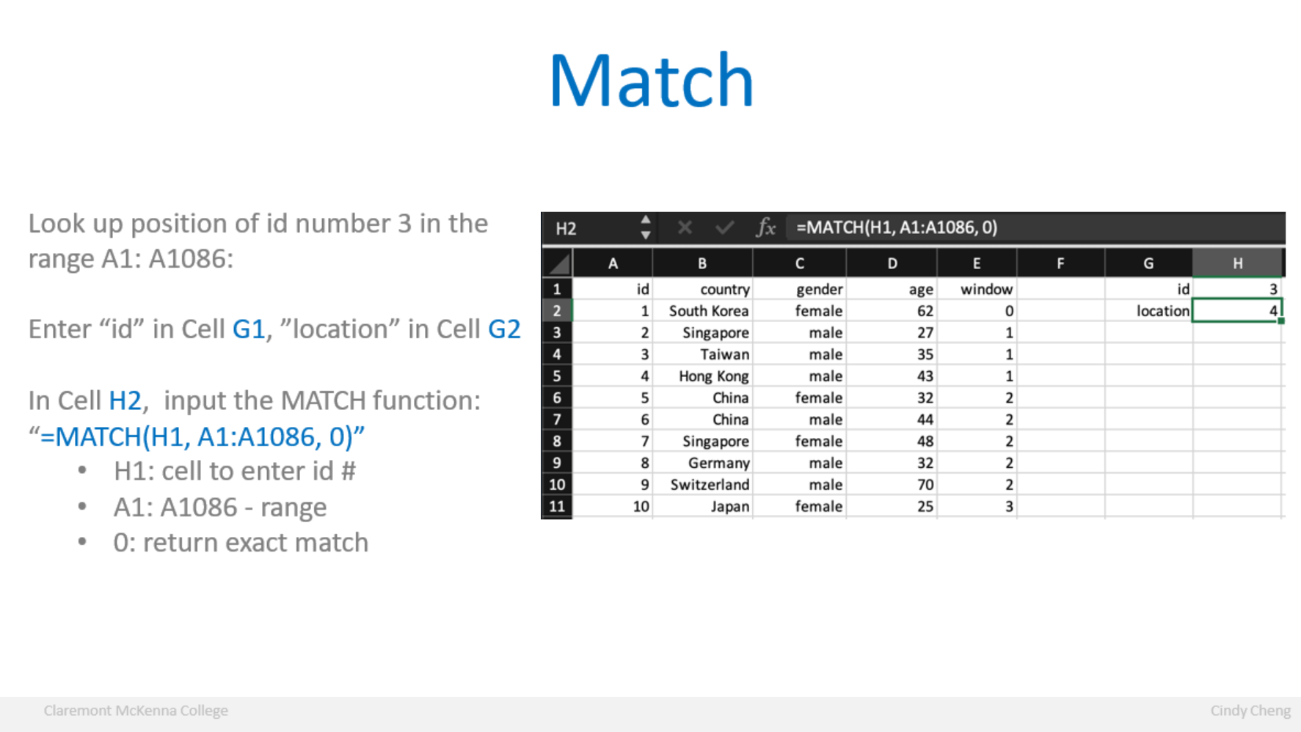

Slide 17
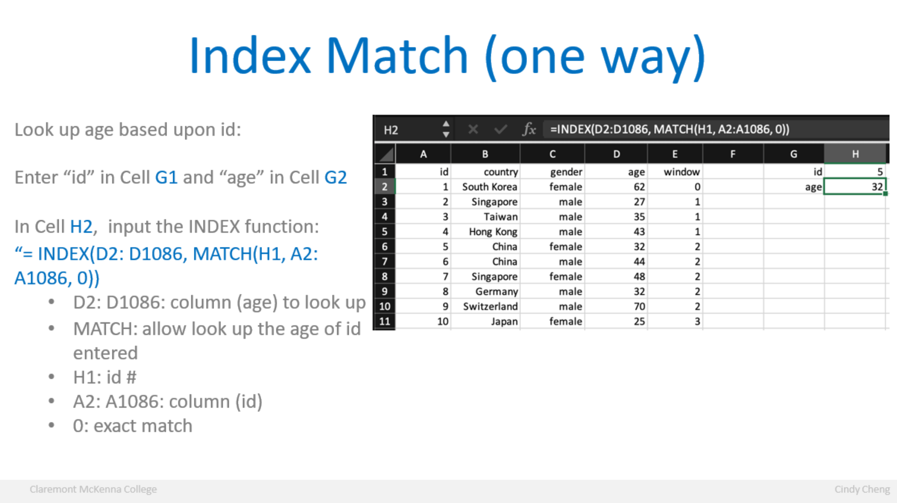

Slide 18
Hands-on exercise #3
Suppose you are a HR specialist and your supervisor, who is the HR director just gave you the baltimore-city-employee-salaries-fy2019-1.xlsx file:
Ennis called you to see what his hire date is.
Create Index Match functions that allow you to input the employid to retrieve the name, hire date.
Given that Ennis’s employee ID is A12393, what is Ennis’s hire date?
https://data.world/baltimore/6xv6-e66h

Slide 19
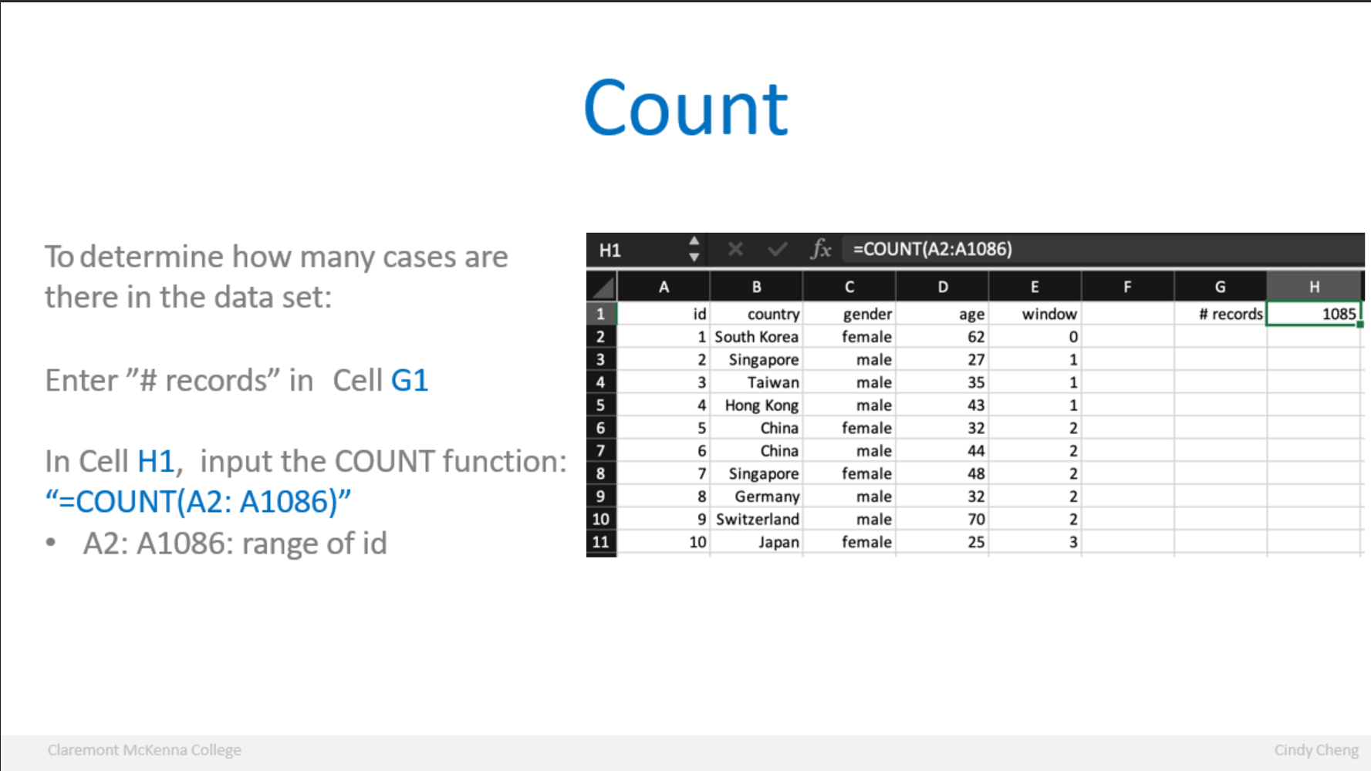

Slide 20
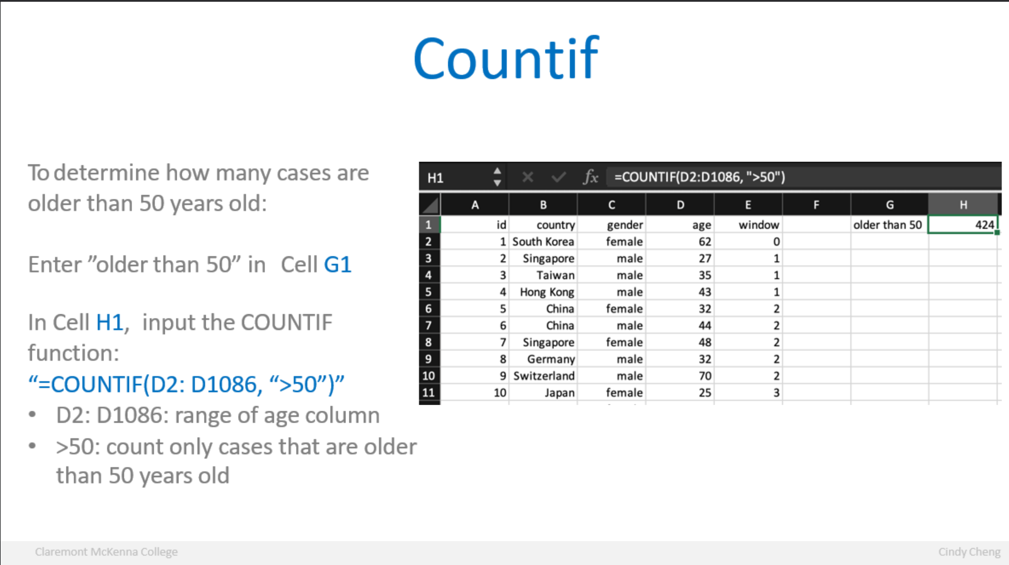

Slide 21
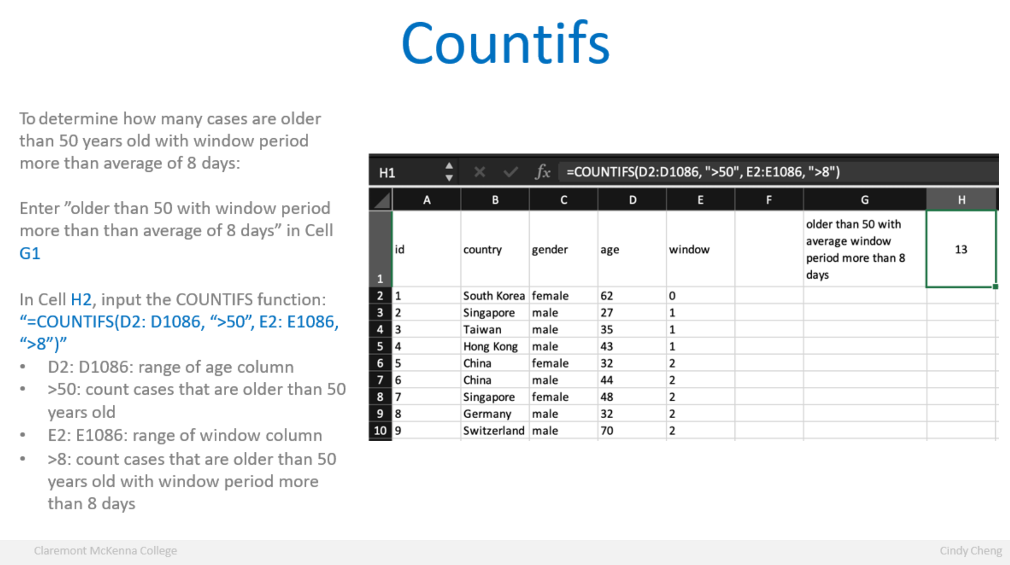

Slide 22
Hands-on exercise #4
Suppose you are a HR specialist and your supervisor, who is the HR director just gave you the baltimore-city-employee-salaries-fy2019-1.xlsx file:
As the fiscal year is coming to an end, you are asked to provide head counts based upon the annual salary level from Question 1 for budget planning. Using COUNTIF, how many employees are in the Entry?
https://data.world/baltimore/6xv6-e66h

Slide 23
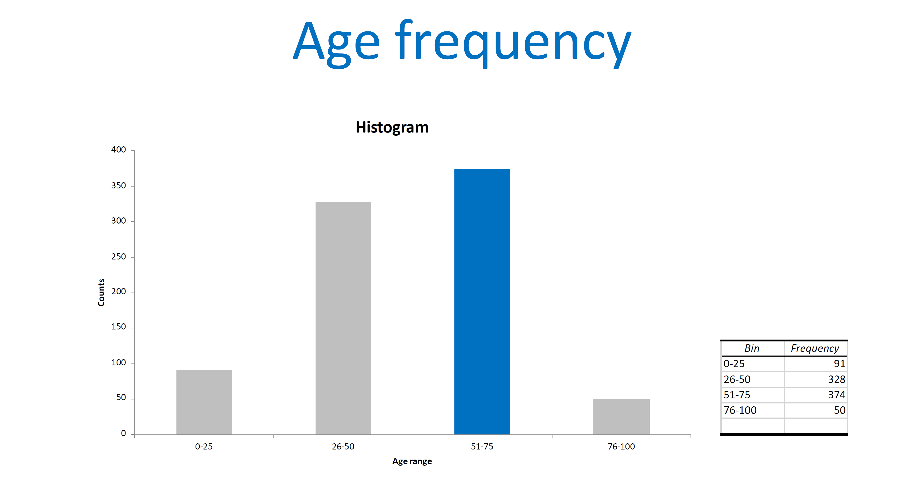

Slide 24
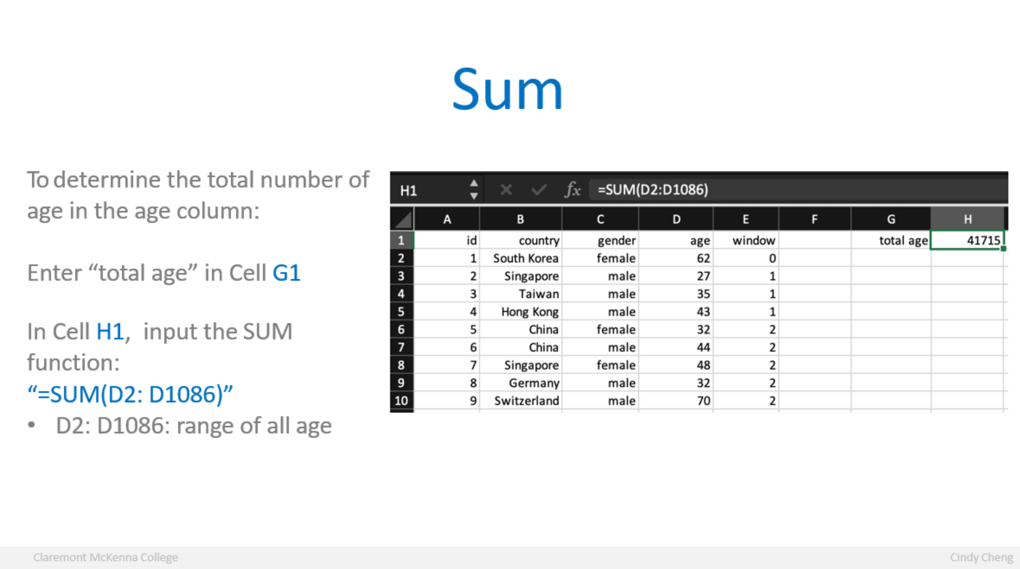

Slide 25
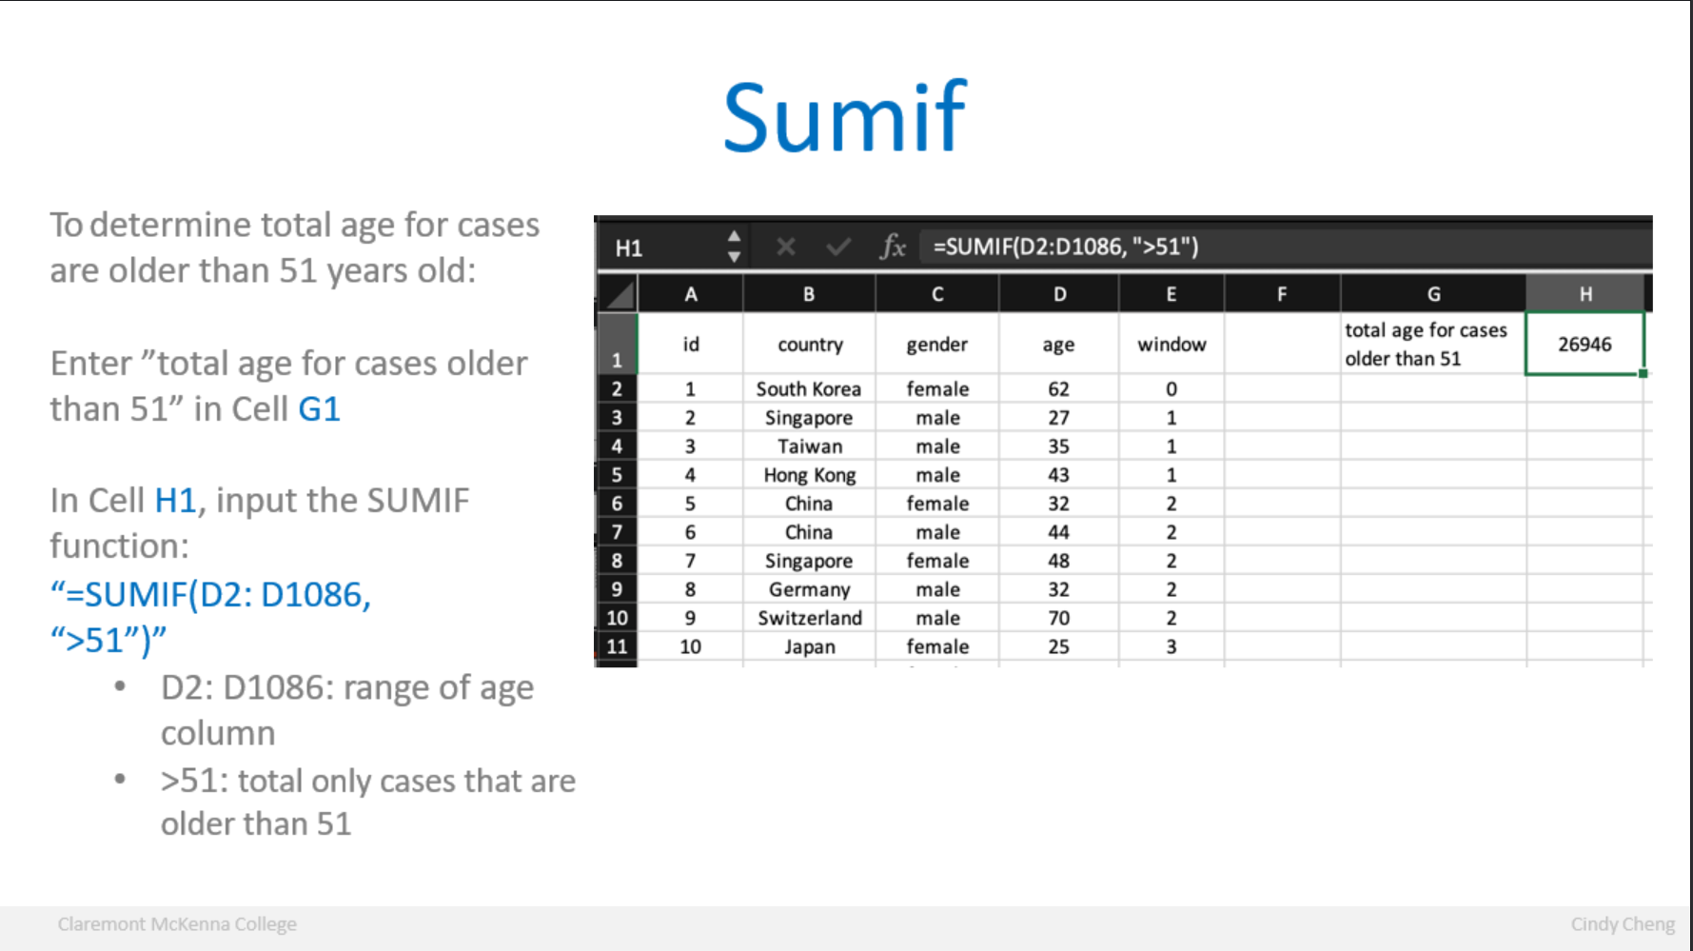

Slide 26
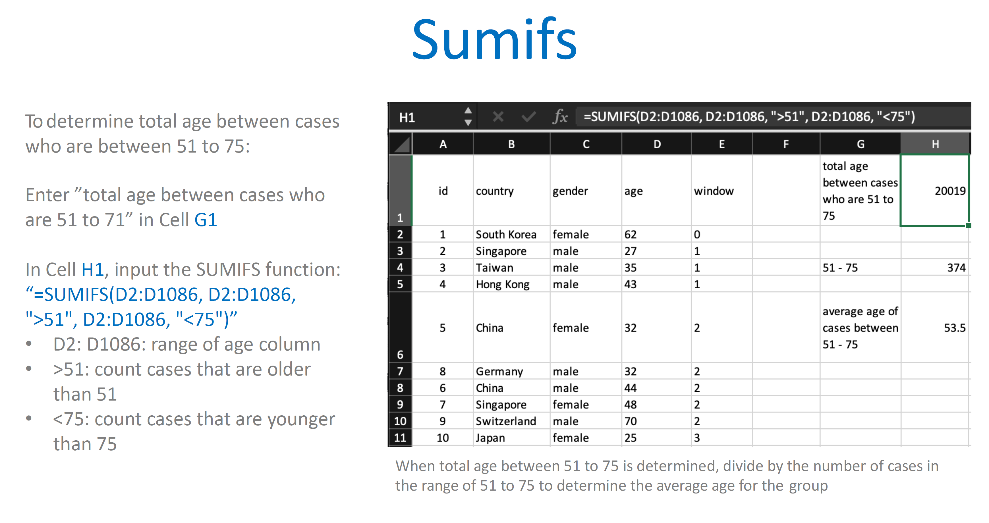

Slide 27

Break

Slide 28
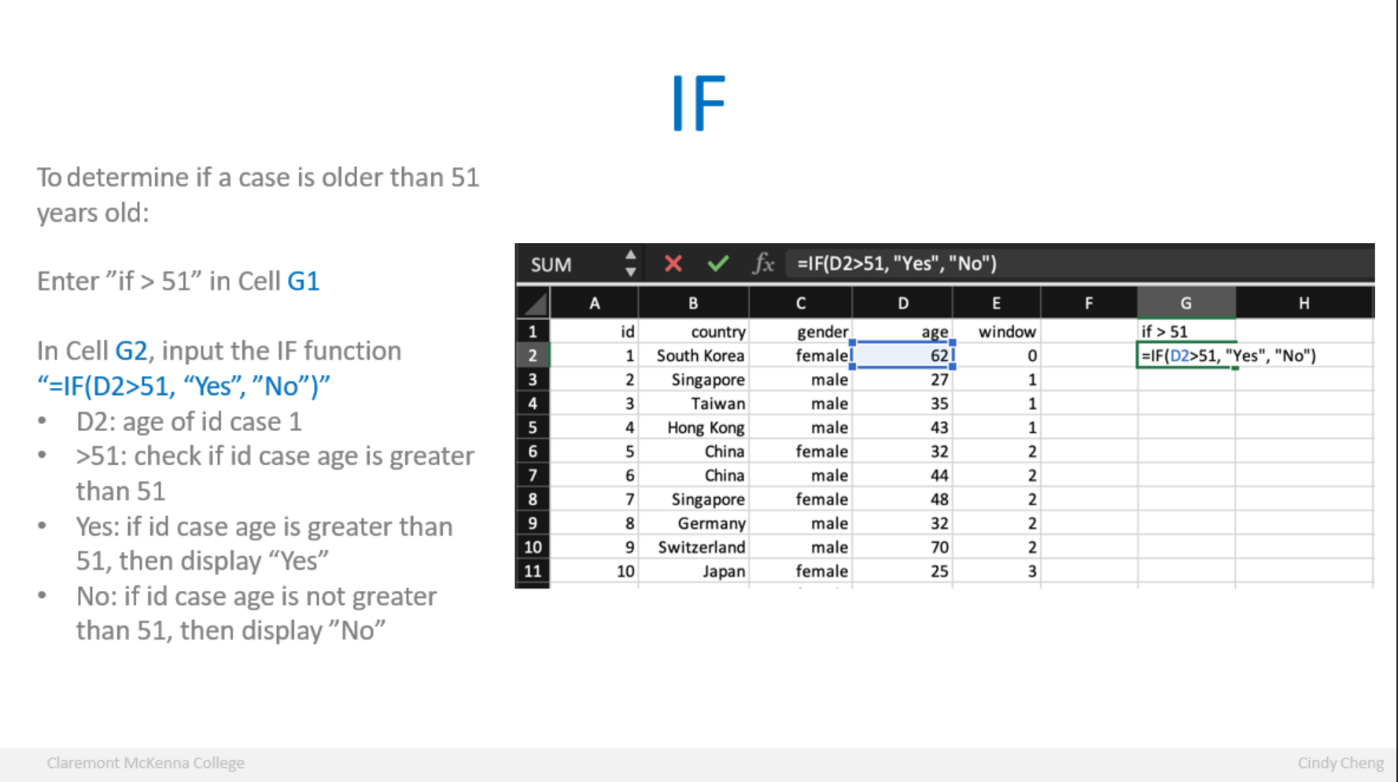

Slide 29
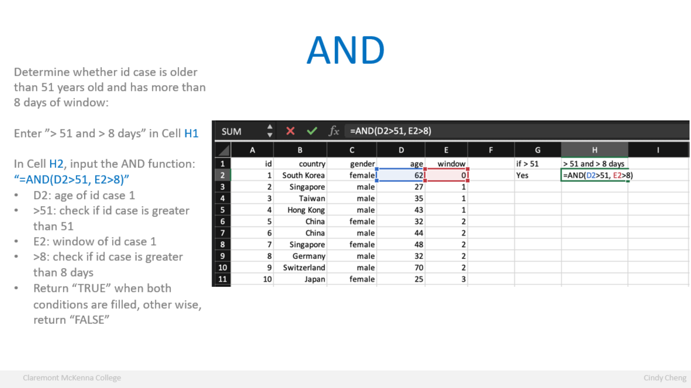

Slide 30
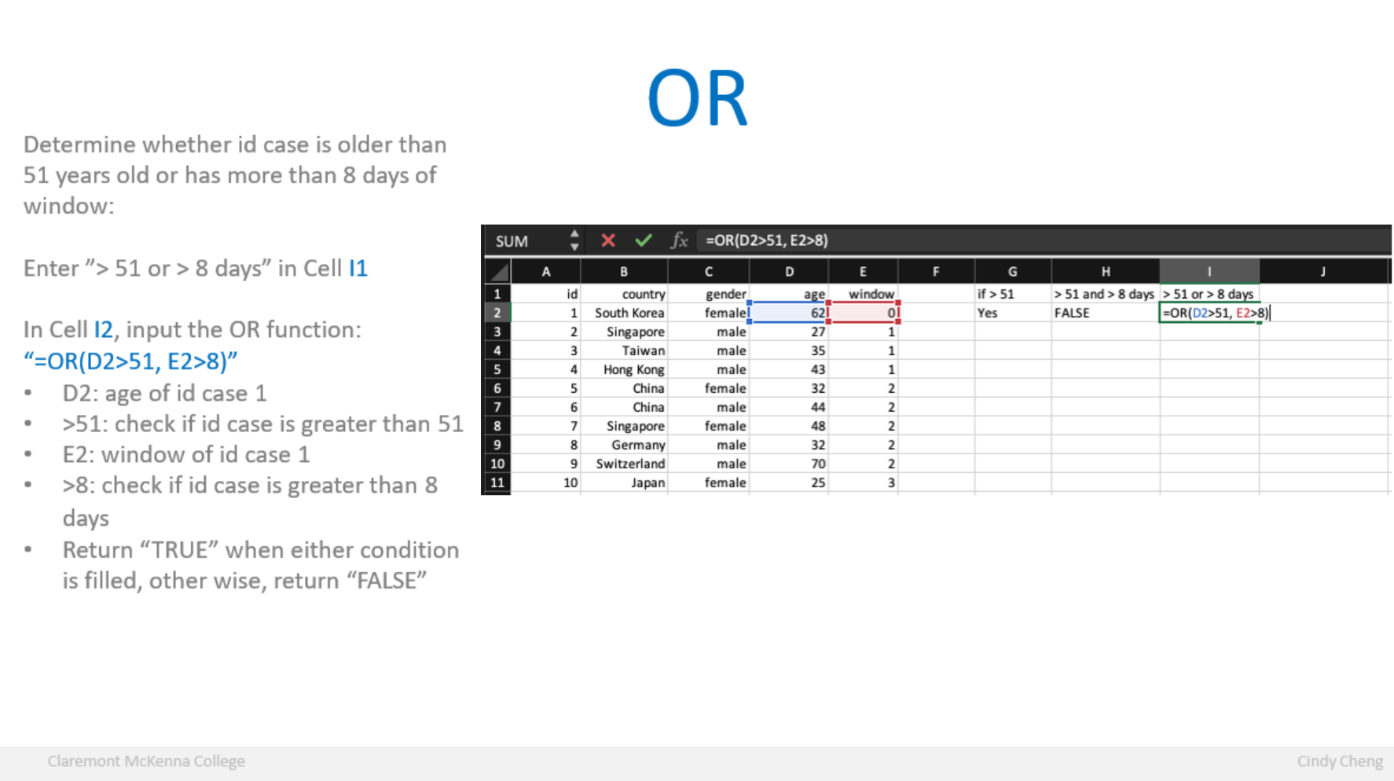

Slide 31
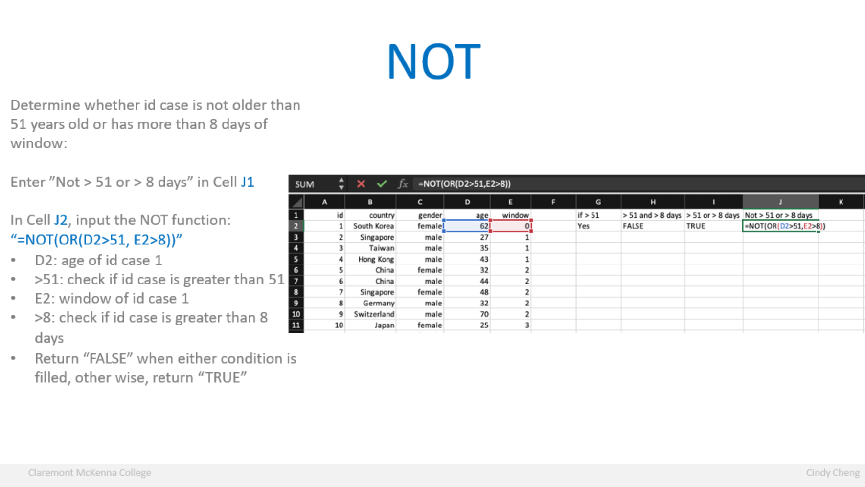

Slide 32
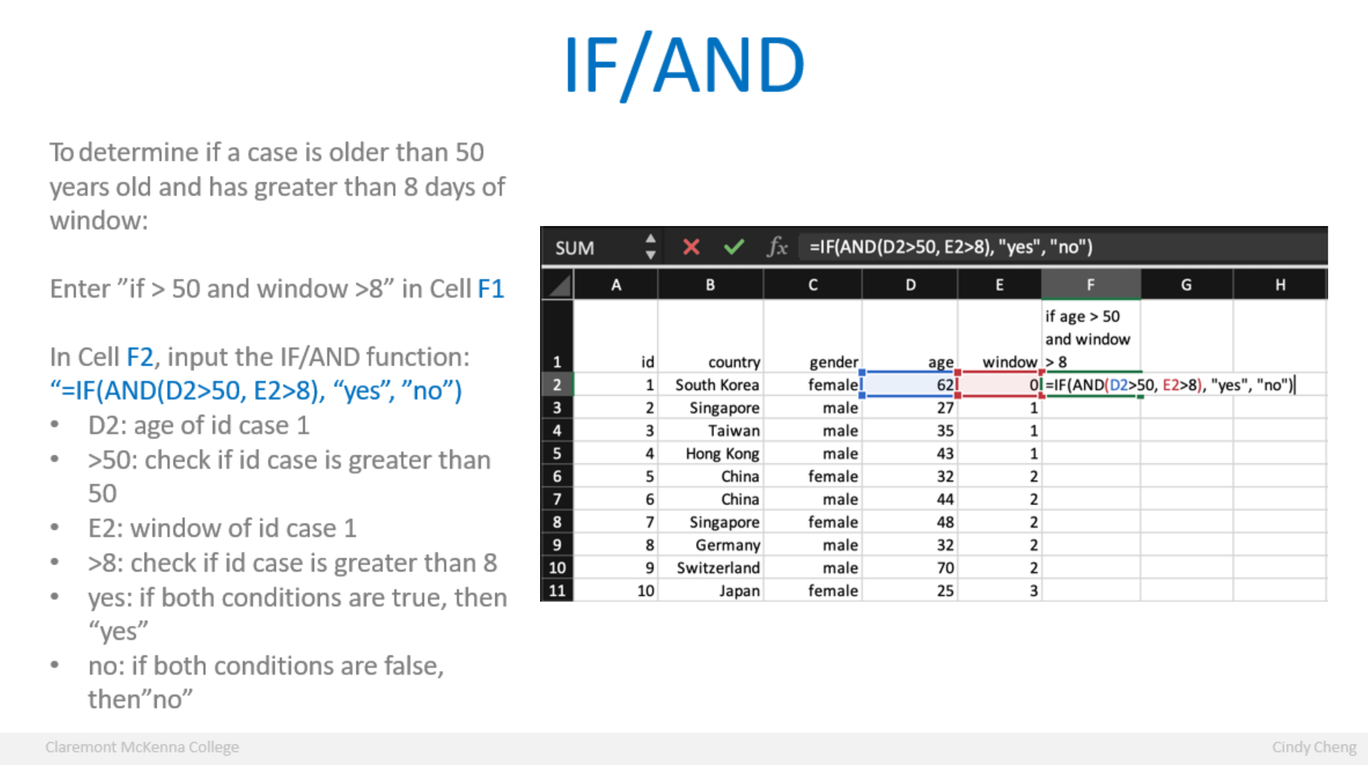

Slide 33
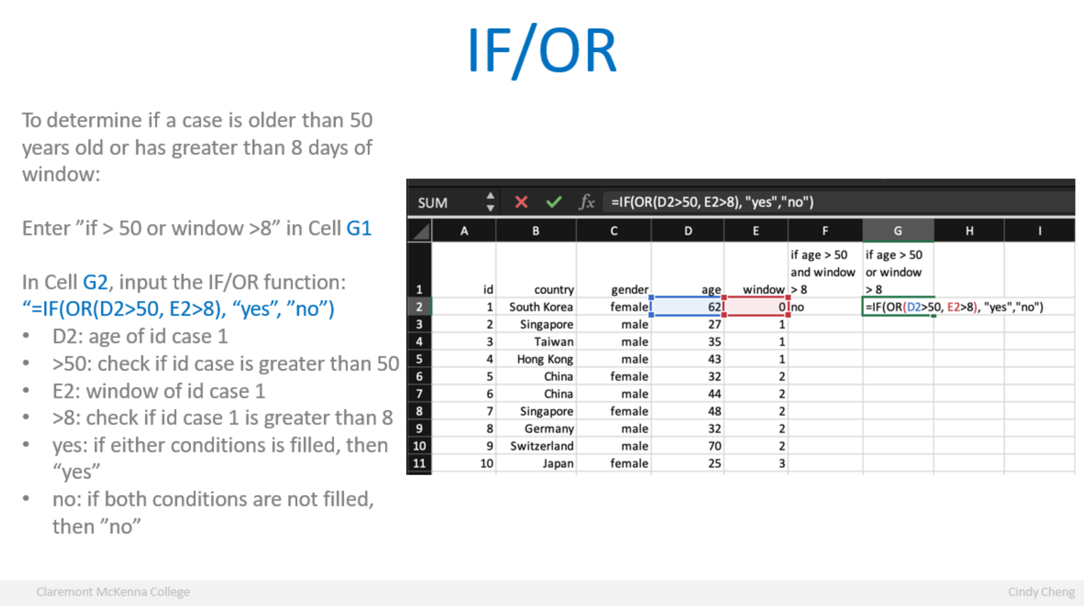

Slide 34
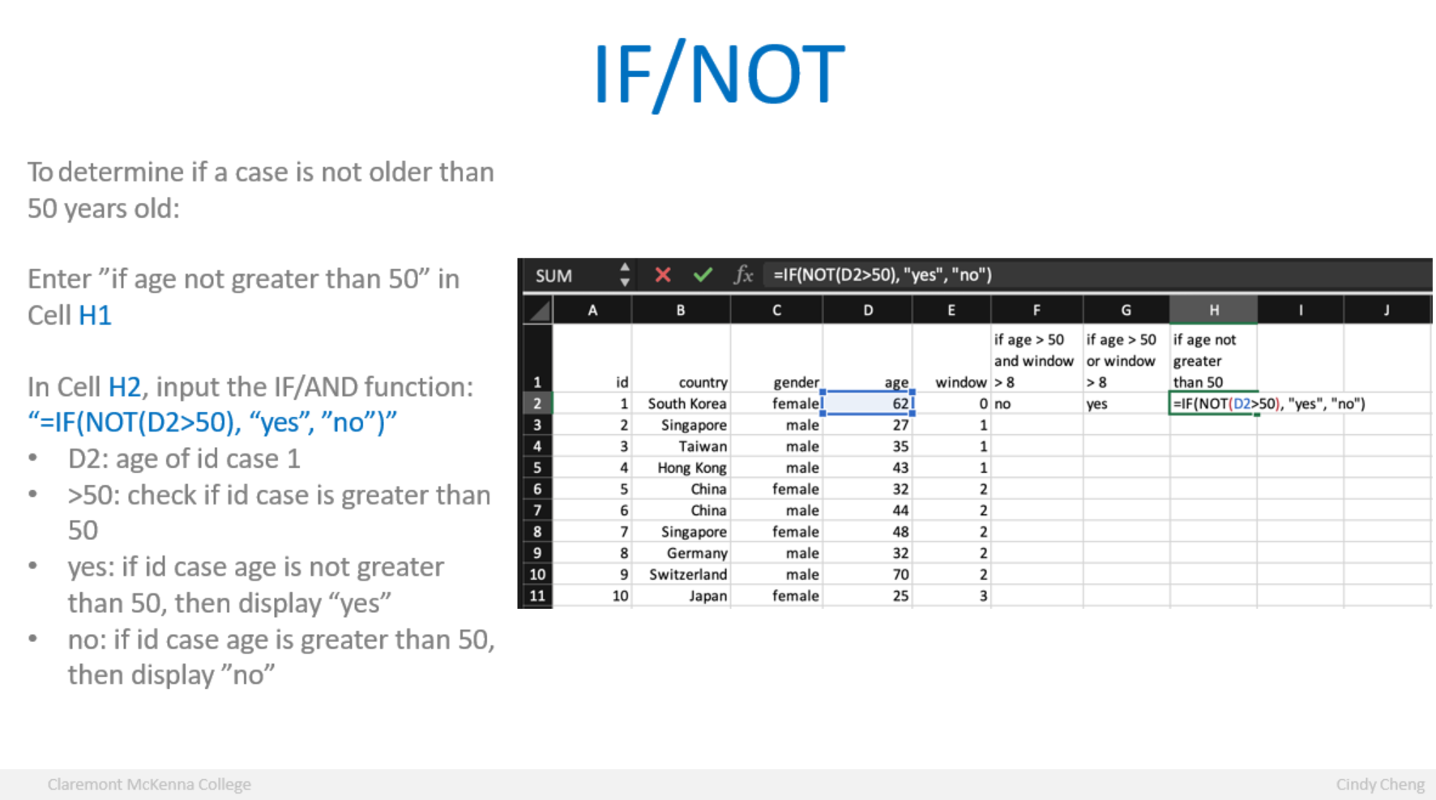

Slide 35
Hands-on exercise #5
Suppose you are a HR specialist and your supervisor, who is the HR director just gave you the baltimore-city-employee-salaries-fy2019-1.xlsx file:
What’s the IF function that allows you to return “yes” for whether the employee is entry level, if not, returns “no”? Use the annual salary for Entry Level employee from Question 1 table for the function.
https://data.world/baltimore/6xv6-e66h

Slide 36
The more you know…
Linkedin Learning: https://www.linkedin.com/learning/?trk=nav_neptune_learning
Excel Practice: https://excel-practice-online.com/
Wise Owl training: https://www.wiseowl.co.uk/excel/exercises/standard/
Hotkeys cheat sheet: https://www.computertutoring.co.uk/cheatsheets/Excel_Cheatsheet.pdf

Slide 37
Questions?
Visit the QCL at Kravis Lower Court or email us at qcl@cmc.edu

